Slide 1

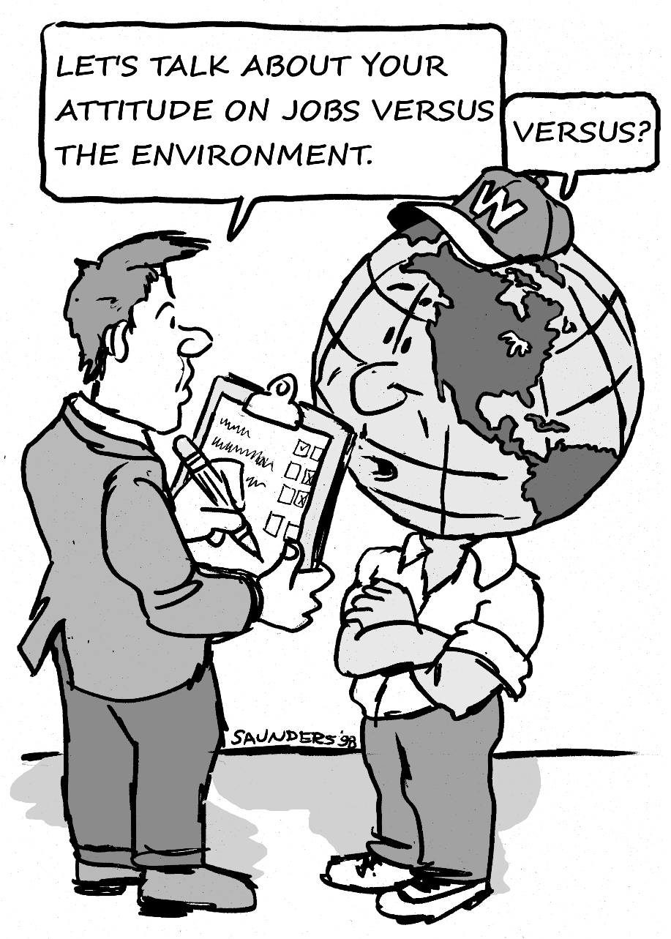
IndustriALL Global Union
COP21
Paris, December, 2015

Slide 2

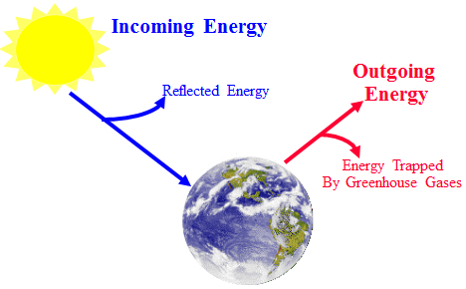
IndustriALL Global Union and Climate Change
Notes:
* There is a natural greenhouse effect that insulates the planet from heat loss.
* It is caused by relatively small concentrations of water vapour, carbon dioxide, methane and other trace gases.
* Ice cores show that past temperature changes in the earth’s history are closely linked to concentrations of these greenhouse gases.
* Without the natural greenhouse effect, the average temperature of the earth’s surface would be 33C colder than present values of 15C.

Slide 3
Intergovernmental Panel on Climate Change –
(IPCC) – process for providing science advice:
Selection of lead authors for technical chapters is based on internationally recognized expertise
Content of technical chapters is based on published literature, with invited contributions from others
Chapters are sent to peer scientists for review, amended, then sent to peer scientists and governments
Final content is the responsibility of lead authors, and is accepted (not approved) by IPCC as expert advice
Consensus summary for policy makers developed and approved collaboratively by IPCC and lead authors
Thousands of climate experts; peer-review is very rigorous

Slide 4
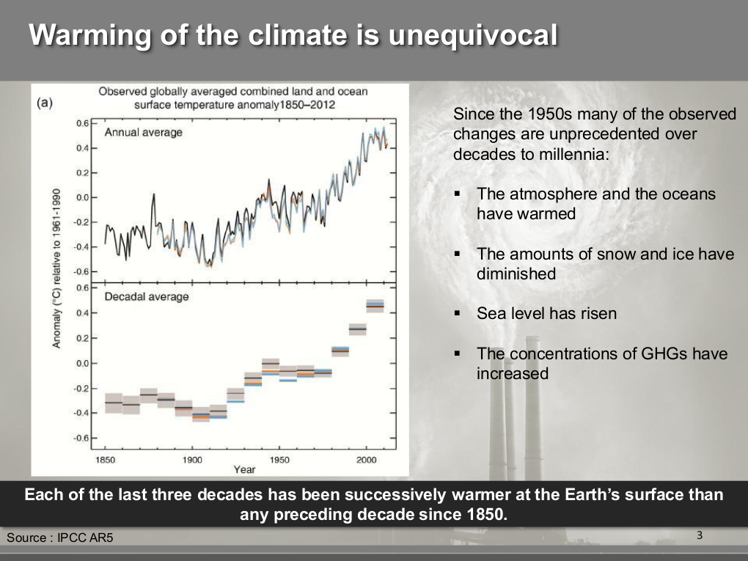

Models including all forcings
agree well with observations

Slide 5
Projected changes in temperature will likely be
unprecedented in at least the past 10,000 years
1000 to 1861, N. Hemisphere, proxy data;
1861 to 2000 Global, Instrumental;
2000 to 2100, SRES projections

Slide 6
Human influence on atmospheric composition
has been dramatic

Slide 7
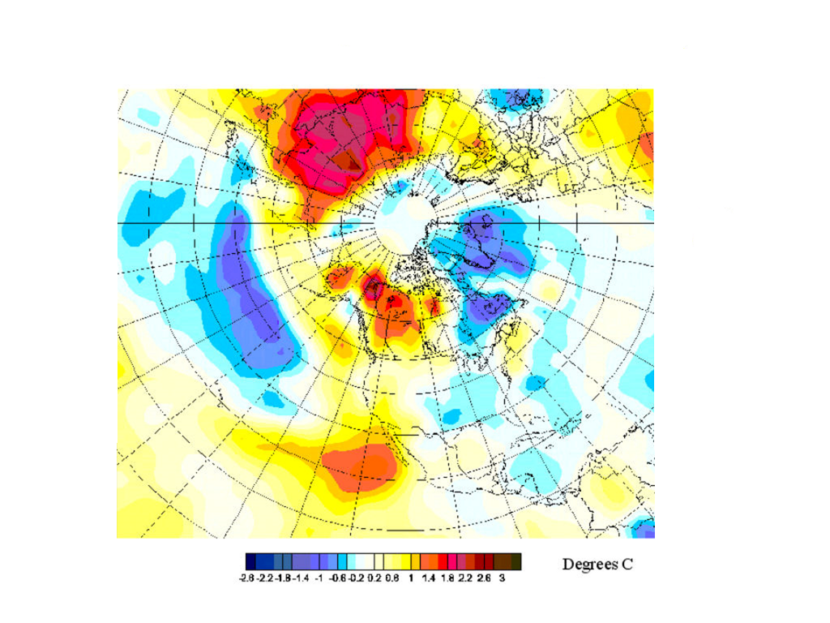
But, changes are not evenly distributed in time or space.
Weather is not climate.

Slide 8
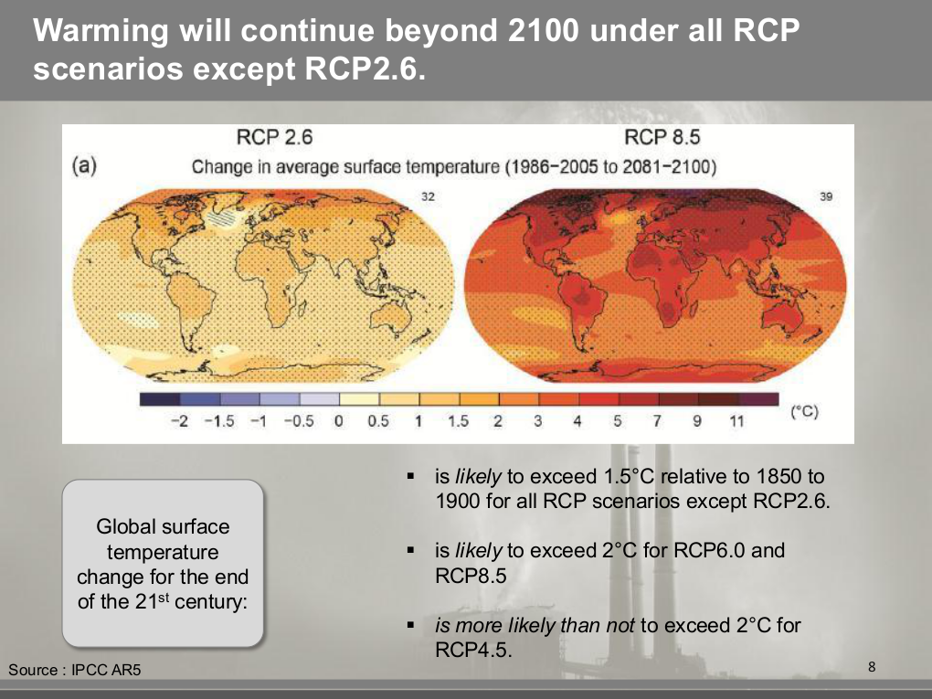
(very aggressive GHG reductions)

Slide 9
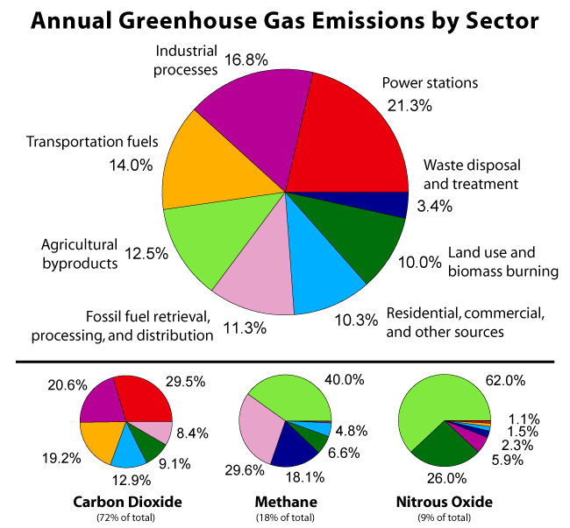
(very aggressive GHG reductions)

Slide 10
adaptation and disaster management are now a key part of the response:
“Many important economic and social decisions are being made today on long-term projects…based on the assumption that past climate data…are a reliable guide to the future. This is no longer a good assumption…”
UNEP/WMO/ICSU Conference
Villach, Austria 1985

Slide 11
Example: one meter sea level rise (by 2100) – a conservative estimate – would be significant to many countries
Selected Impacts :
  15% loss of agricultural production in Egypt
  20% loss of agricultural production in Bangladesh
  10 million people directly affected by flooding in Bangladesh alone; millions of climate refugees
  $ trillions in property loss
  Near total loss for some island states

Slide 12

All signs indicate:
that there WILL be a Paris Accord
Notes:
12
12

Slide 13
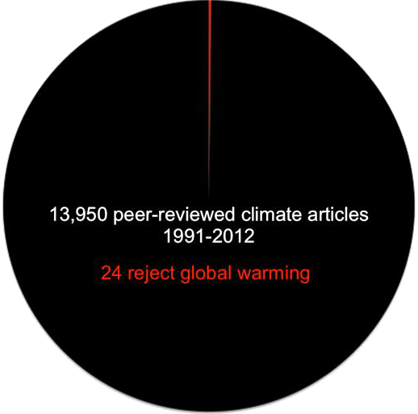
Yes, it’s a pie-chart.
Notes:
13

Slide 14
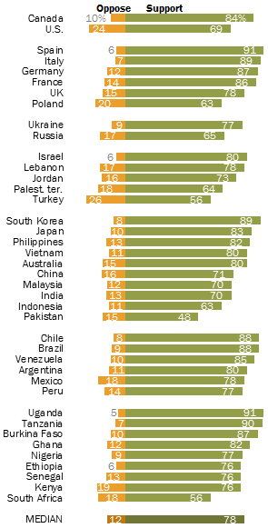
Do you support/oppose your country limiting greenhouse gas emissions?
Source: Spring 2015 Global Attitudes Survey Q40, Pew Research Center
Notes:
14

Slide 15
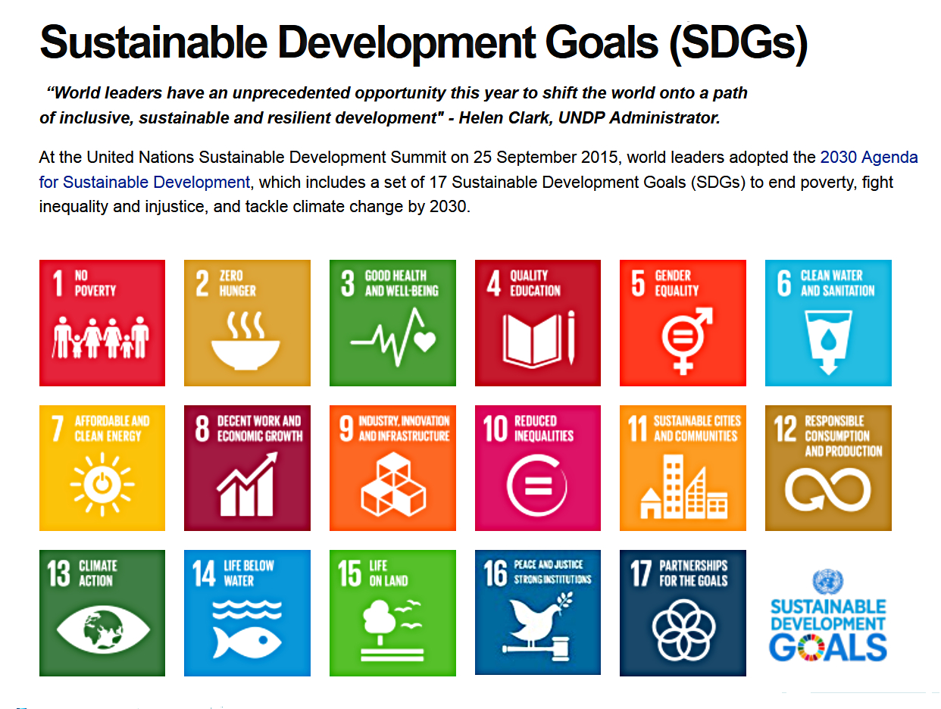
Notes:
15
15

Slide 16
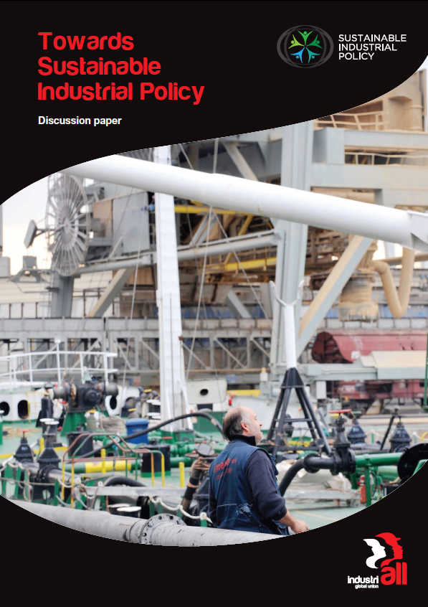
http://www.industriall-union.org/issues/pages/sustainable-industrial-policy
Notes:
16

Slide 17
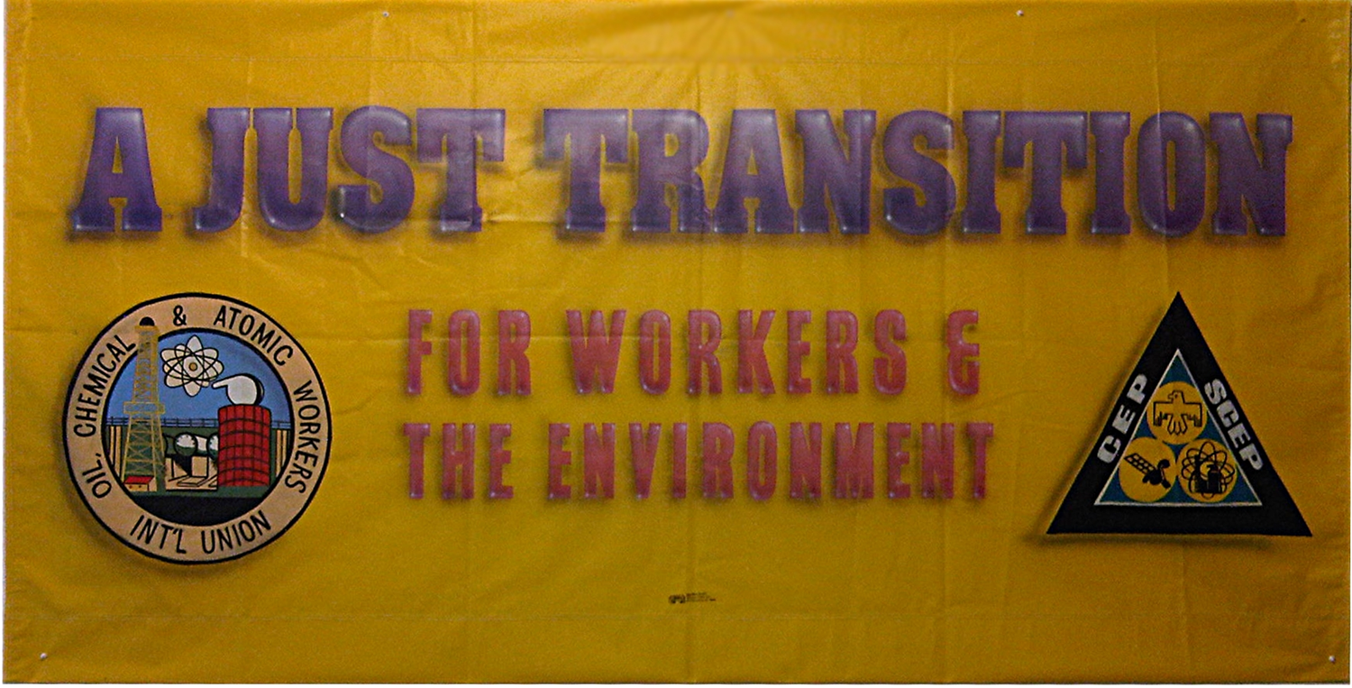
This would not even be a point of discussion if not for the work of IndustriALL and its predecessors!
Getting There from Here :
a concept whose time has come

Slide 18
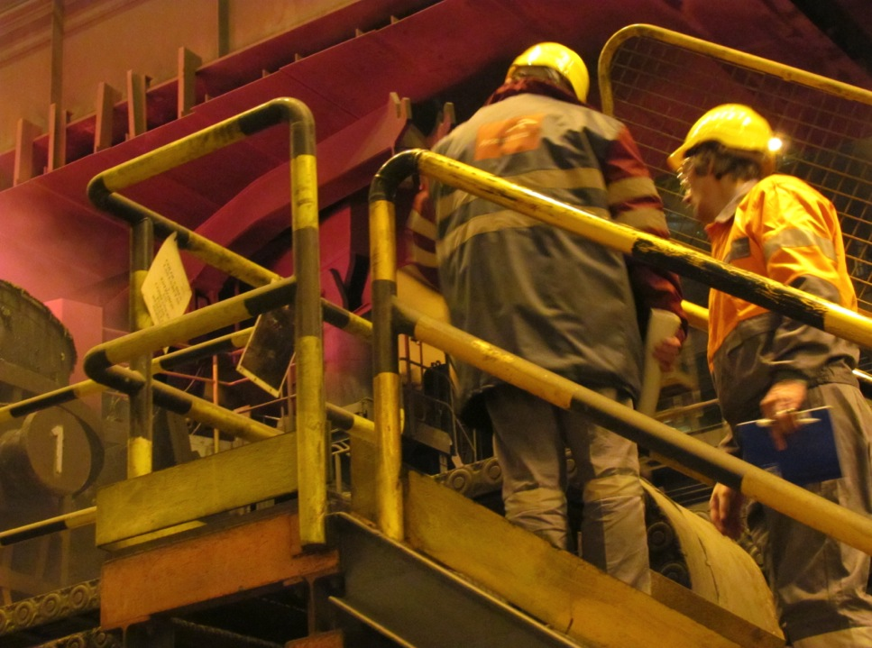
Just Transition
a pathway towards a sustainable future; a prerequisite to progress
reduces fear by promising fairness, a sharing of costs / benefits
seeks positive benefits for both present-day workers, and future workers in greener industries
rests on three elements:
• sustainable industrial policy,
• robust social protections,
• creative labour adjustment
programmes

Slide 19
ILO Guidance on Just Transition
I. Policy coherence and institutions (country specific)
II. Social dialogue (multistakeholder)
III. Macroeconomic and growth policies
IV. Industrial and sectoral policies (greener jobs; decent work)
V. Enterprise policies
VI. Skills policies (also education)
VII. Occupational safety and health
VIII. Social protection policies (health care, income security, social services)
IX. Labour market policies
Getting There from Here :
a concept whose time has come

Slide 20

IndustriALL Global Union:
Sustainable Industrial Policies:
Just Transition: Who benefits? Who pays?
Discussions: if changes are coming they must be managed
in a socially responsible
manner
Industrial policy + sustainability

Slide 21
Industrial policy
A plan to encourage desired patterns of industrial development and growth
Strategically targets specific industries and sectors
Considers transportation and communications infrastructures, education and skills, training, research and energy
Creates a healthy economy and quality employment
Minimizes negative environmental impacts
Advances the interests of society as a whole

Slide 22
Just Transition
society must make decisions to protect environment
workers (families, communities, unions) should be kept whole - in the absence of a Just Transition program, workers will almost certainly bear the costs.
a truly Just Transition, is not a “nice funeral”
Just Transition must offer a future to existing workers: fear prevents movement !

Slide 23
Robust Social Protection
Health care, pensions, education, and all sorts of social safety nets are a fundamental part of any society that claims to seek fairness
If we are serious about moving towards sustainability, we should be strengthening them, not attacking or weakening them
The ideological attacks on social programs of all sorts can be seen as one of the obstacles to effective action on climate change

Slide 24
Creative Labour Adjustment
For Just Transition, we need an all-encompassing, flexible approach to helping workers, their families, and their communities deal with changes, and it must ensure that existing workers in existing jobs benefit from the move to sustainability, as well as future workers in new industries (which we must ensure create decent work). Existing workers cannot simply be left behind to face unemployment
A Just Transition must involve all affected workers in its design and be customized to each situation. A Just Transition can include: preferential placement with full maintenance of pay and benefits, education and training programs, enhanced early retirement for older workers, consideration for families, communities, institutions, unions !

Slide 25
Some Sectors with Greener Job Potential
examples only: not an exhaustive list)
Transportation: public transportation, transportation systems, more efficient private transportation
Agriculture, Construction, and Forestry: more efficient machinery, sustainable methods and processes
Energy: more efficient energy generation using existing fuels, renewable energy, energy efficiency, efficient grids, insulation
Construction: greener buildings, and building systems
Recycling: must be made much more efficient
Greener industry, “Industry 4.0”, sustainable chemistry, etc.
we must be cautious that these are not used against us

Slide 26
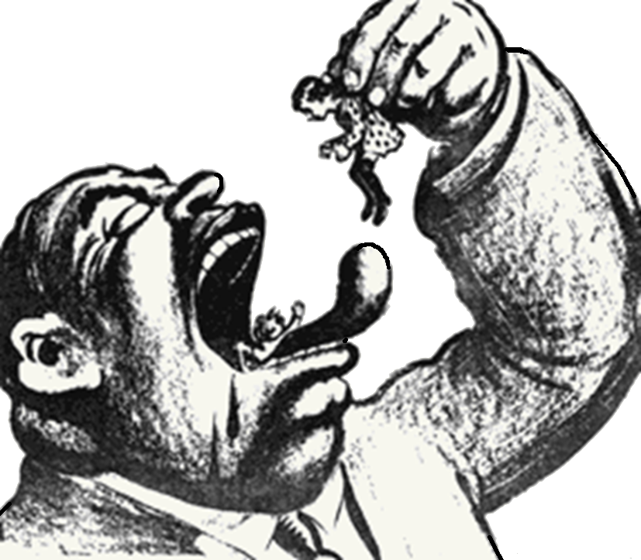
market-driven adaptation solution?

Slide 27
Short-Sighted Thinking
What answers does the industry have to the obvious questions being asked?
Will it be seen as part of the solution, or only part of the problem?
Credibility: the industry must consider what role it will play
A new global regulatory framework is emerging; although weak presently

Slide 28
Overriding Conclusion
Outcomes are well predicted by the public policies (or lack thereof) chosen to achieve them. Policies specifically aimed at the renewable energy industries are not the only policies of importance, austerity measures and attacks on social safety nets and public institutions also play a role. Unions can’t wait passively.

Slide 29
Notes:
29
29

Slide 30
Paris Regime
Possible content
(Countries have already made commitments)
(1) Agreement - core, legally binding
(2) Decision - details that will evolve
• Agreement: levels of responsibility, commitments re:
(i) mitigation; (ii) adaptation, (iii) loss and damage
Mitigation – Will try to maintain global average warming to less than 2 C degrees over pre-industrial levels. Global GHG emissions to peak and decrease soon, must trend towards zero net emissions. Arguments about time-frames, levels of progress reporting and verification. Implementation via nationally-determined commitments.
Notes:
30
30

Slide 31
Paris Regime
Possible Content
Adaptation - Economic diversification and cooperation recognized; this in fact will necessitate national industrial strategies. Financial, technical aid for developing countries. National plans must consider communities, ecosystems, women, indigenous peoples;
Loss and Damage - Eemergency preparedness and response must be part of the planningAccess to adequate financing. $100B/year USD climate fund. Sounds like a lot, but trivial compared to the amount spent on military; to the amount spent bailing out the banksters; or to the USA national debt. Achieving this level of funding is only a matter of priorities. Nations that will be providing this funding demand assurances of transparency and accountability and tracking of results/progress; they will get something - a clear reporting process will be beneficial.
Notes:
31
31

Slide 32
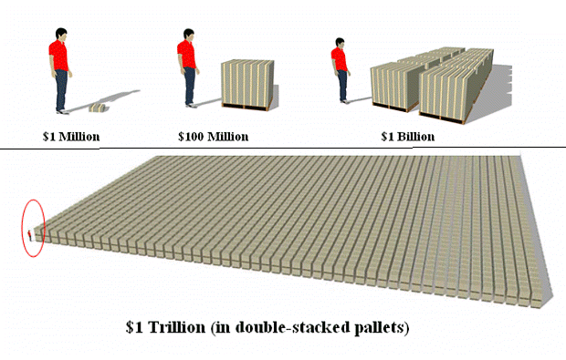
Climate fund : ͠ $0.1 T annually
Global military : ͠ $2 T annually
Banks, Globally: ͠ $14 T
Banks, Swiss: ~ CHF 68 B

Slide 33
Paris Regime
Possible Content
Draft Decision
This is where Just Transition is first mentioned: in the preamble to the "Draft Decision“ which is the weakest part of the weakest half of the overall Paris document.
"Emphasizing the importance of respecting and taking into account human rights, gender equality, the rights of indigenous peoples, inter-generational concerns, and the needs of particularly vulnerable groups, including women, children and persons with disabilities, when taking action to address climate change, as well as of aligning actions with the goal of promoting food security, restoration of degraded lands, national health policies, participation in environmental decision-making by civil society and individuals, and a just transition of the workforce and creation of decent work and quality jobs in accordance with nationally defined development priorities and strategies;"
Notes:
33
33

Slide 34
Paris Regime
Possible Content
Draft Agreement
However, due to intensive pressure by the labour movement on national governments, Just Transition now also appears in the preamble to the Agreement and also as an option in Article (2).
This is very important; and it will be up to us to ensure (1) that it stays in the Agreement; and (2) that we develop a strategy to pressure national governments to implement it.
Notes:
34
34

Slide 35
why is it our issue?
IndustriALL’s Five Strategic Goals:
  1. Build union power throughout the world
  2. Confront global capital
  3. Defend workers’ rights
  4. Fight precarious work
  5. Ensure sustainable industrial employment
  … it’s not just about Goal 5 !!

Slide 36

  This is a class war :
  Like it or not, a transformation is coming. Will it be a violent scramble for resources such as water, energy, and fertile land; desperate last-minute survival measures that completely dismiss human rights and social protection; or an orderly and Just Transition that respects and protects present-day workers while creating new decent work in sustainable industries?
  "The casino economy has no answers to these questions. We must plan a hopeful future for all workers, including those in industries that may be impacted by efforts to limit greenhouse gases. It is simple social justice".
  - Jyrki Raina

Slide 37
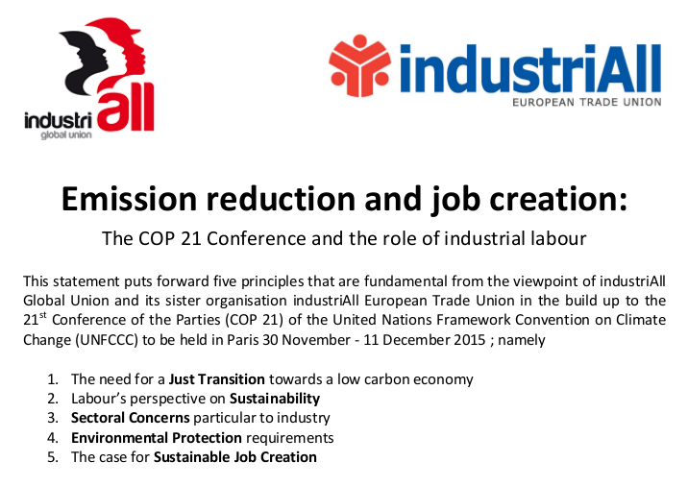
http://www.industriall-union.org/climate-change-is-union-business

Slide 38
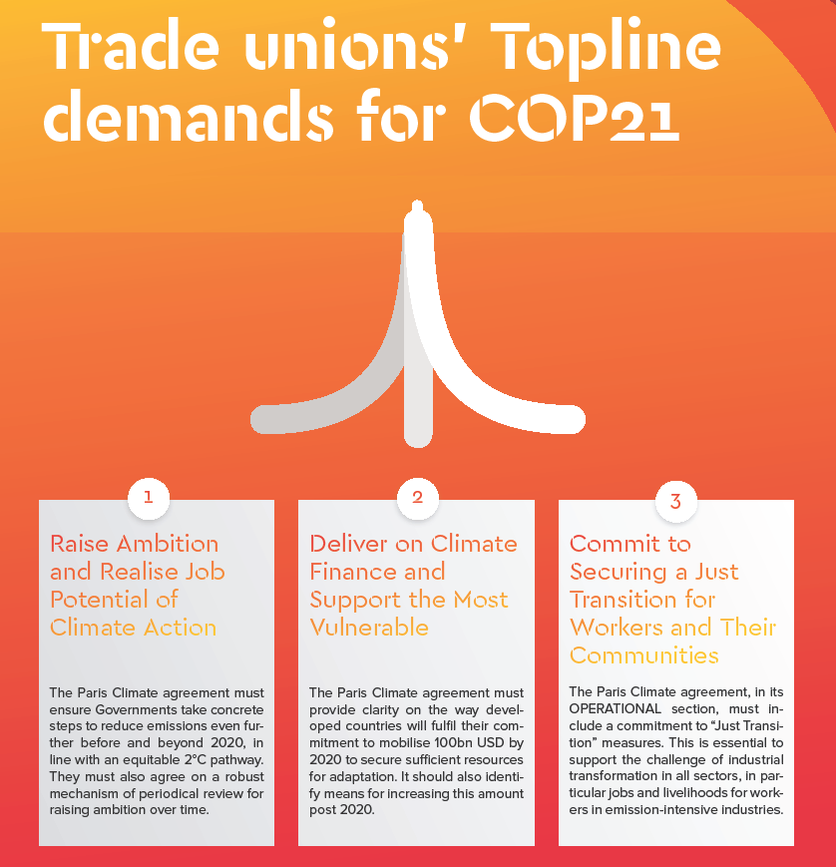
Notes:
38

Slide 39
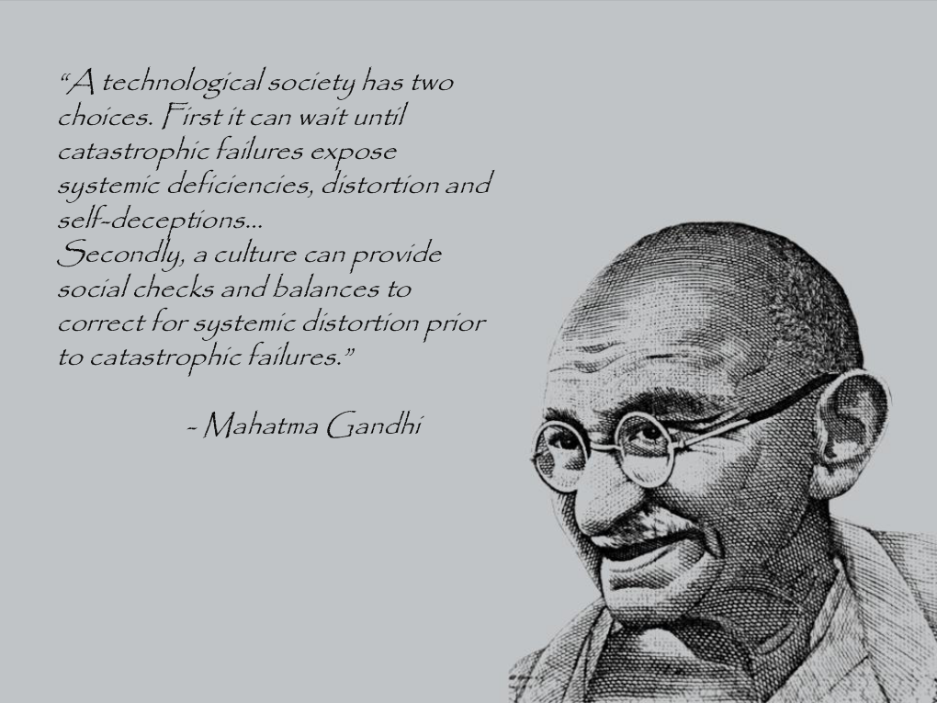
“common but
differentiated responsibilities”?

Slide 40
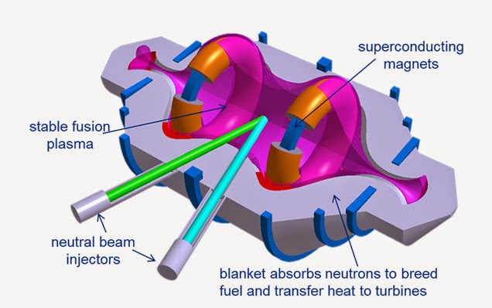
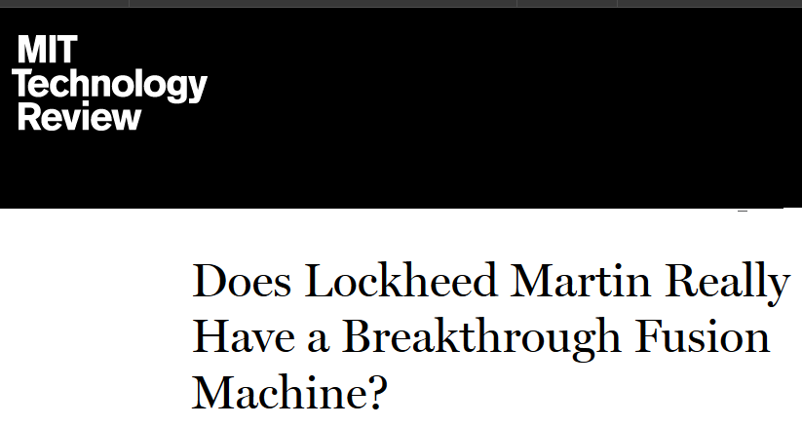
May not be real, but we need to keep our minds/eyes open

Slide 41

Two opposing trends:
• Greater corporate control of the world ?
• Greater global control of corporations ?
Which future will win ?

Slide 42
  Web Links for Documents

Slide 43

Brian Kohler
Director – Health, Safety, Sustainability
IndustriALL Global Union
… Thank You!
Brian Kohler
Director - Health, Safety and Sustainability
IndustriALL Global Union
Notes:
43
43
43
43

