Slide 1
Challenges and a sustainable industri policy for the future.
Mohammad Afzal, Norwegian United Federation of Trade Unions
Notes:
Dear colleagues
I have been asked to talk about how the Norwegian maritime cluster looks like and how it functions and how it has been changing over the years more and more into specialized ships and offshore equipments with advanced technology.
I will also take the opportunity to prove wrong the notion that shipbuilding has moved away from Europe and the Nordic countries because of high costs.
As I will try to show you the maritime industry has in fact strengthened its position in Norway over the last 10 years, and now creates more employment and much more value than it did 10 years ago.
The main driver is the worlds demand for energy and for us, of course, especially related to our offshore oil and gas sector on the Norwegian continental shelf.
XXX
And explanation is naturally that we have become big in the production of highly technological vessels and equipment. We do not produce hulls any more, but we import hulls and equip them to respond to high technological and environmental demands.

Slide 4


Norway - A Complete Maritime Cluster
Bank and finance
Fish&Sea
Shipyard
Research
Assurance
Equipment producers
Ship owner
Seafarer
Ship design
Financing
Classing
Petroleum
Legal
Education
Notes:
Before I came to Fellesforbundet I was managing director for the Norwegian maritime forum for five years, and I always started my introductions or presentations with this slide. The rings in the water shows the maritime cluster, with the ship-owners and the seafarers as the core. They are the core because you of course need ship-owners to invest in building ships and you need to have sufficient basic maritime skills in the cluster. In many ways this slide also shows the members of the Maritime Forum in Norway.
The maritime cluster composed of four main groups: ship owners, maritime services (such as legal, insurance, finance, design and so on), ship equipment and ship building. These main groups are surrounded by facilitating industries. The Norwegian Maritime cluster has another special feature, its close relation to the oil and gas sector, bank and finance and IT has resulted in a niche where Norway has a competitive advantage over other shipping clusters. I used to say that the success criteria for the Norwegian maritime cluster is that we got high competence in all of the four main groups and at all levels…
Two of the largest shippingbanks in the world are located in Oslo, namely DNB and Nordea has its headquarter for shipfinance in Oslo.

Slide 5
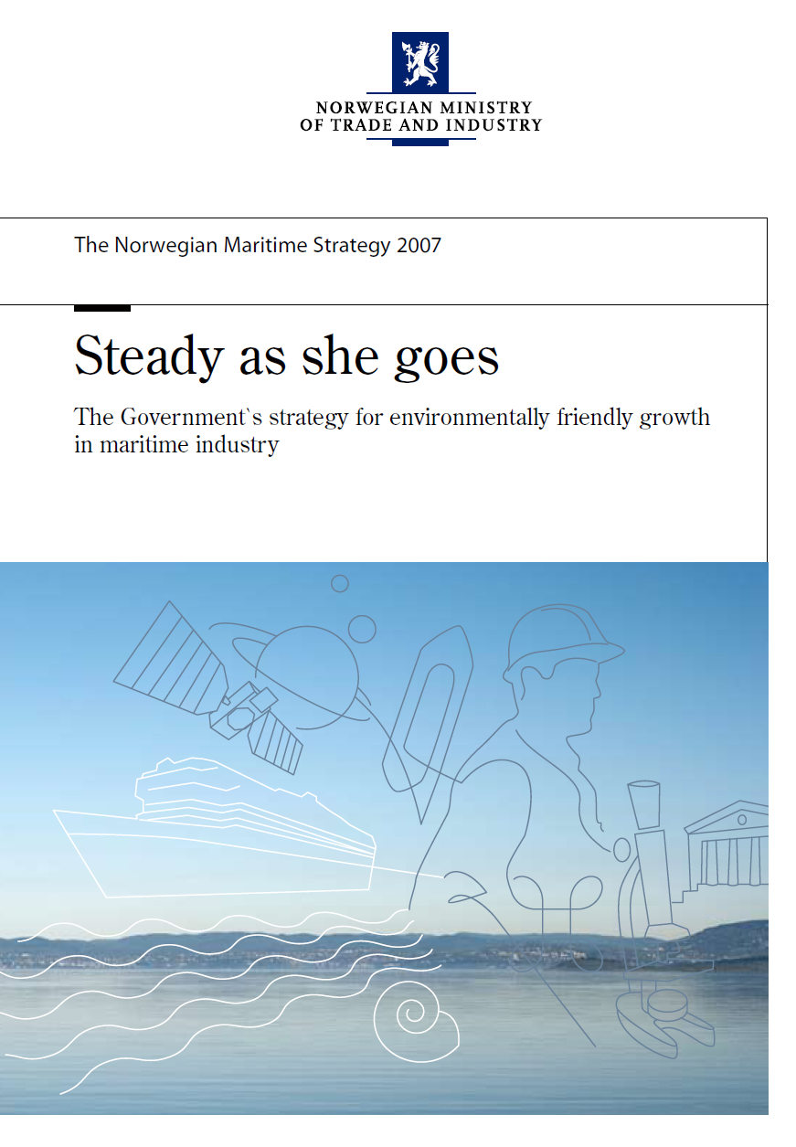
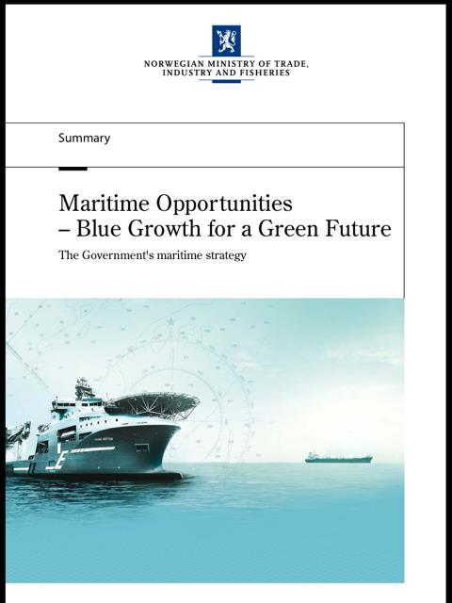

Slide 6
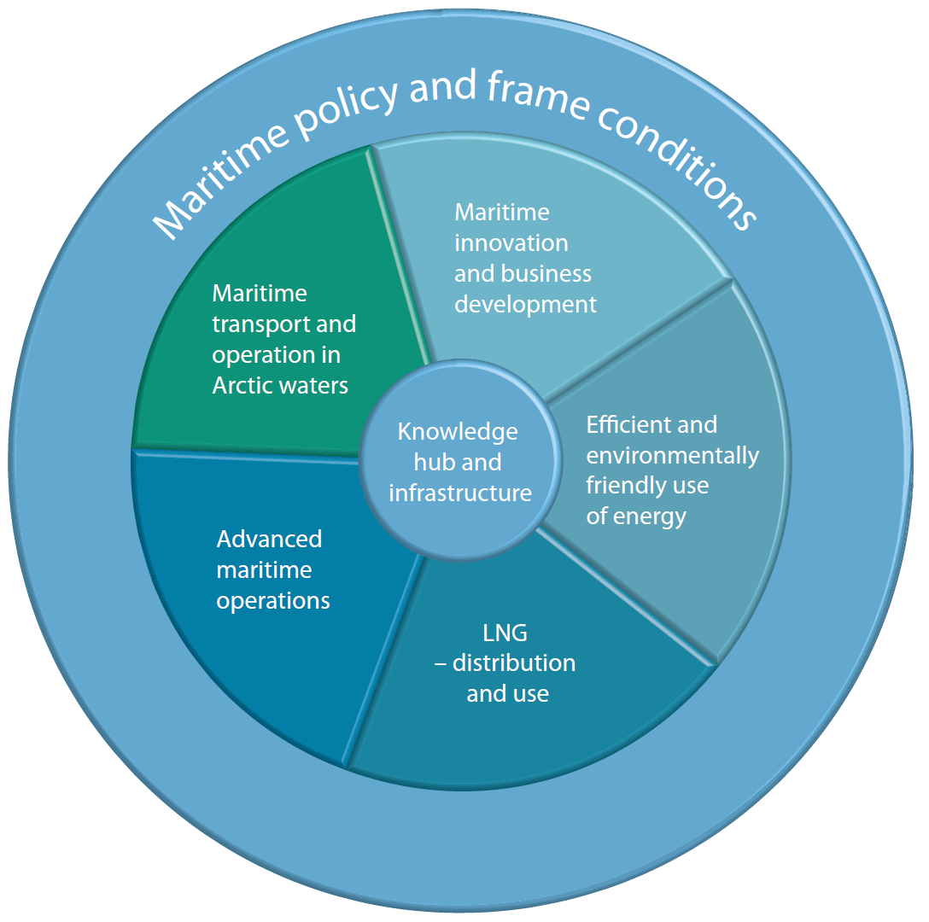
Maritime 21 is the maritime industry’s recommended strategy for research and innovation
The industry’s vision:
  “Norway – Shall be the most attractive location for global, knowledge based and environmentally
  robust maritime industry”
www.maritim21.no
Notes:
I would also like to mention Maritime 21. this is the Clusters recommendations for focus areas in the maritime policies in Norway for the future
There is Established a working group for further concretisation and recommendations to the Governement
Seven priority areas
We wil start with focusing on Liquid Natural Gas og Energy efficiency in 2011

Slide 7
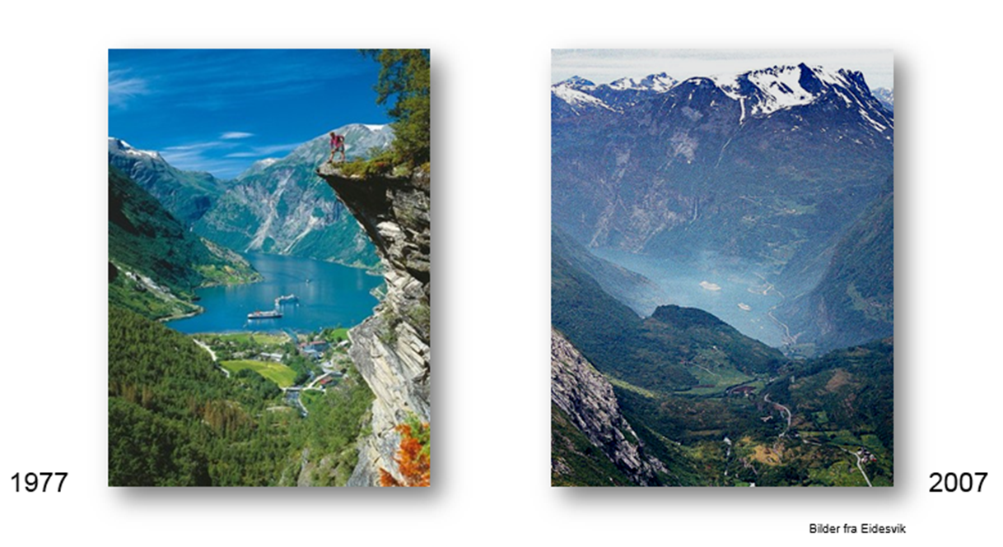
The Geiranger fjord

Slide 8
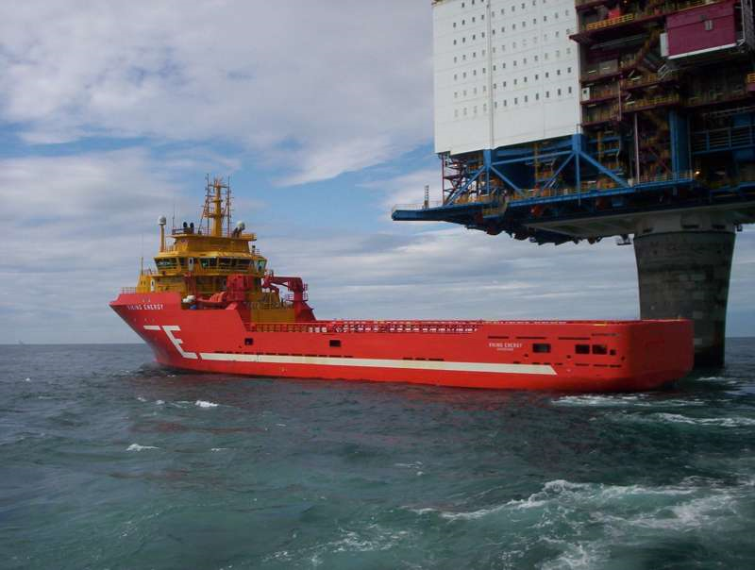
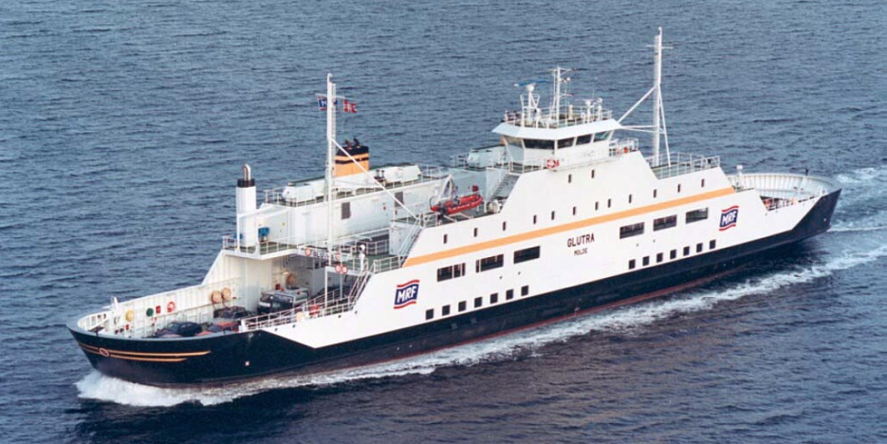
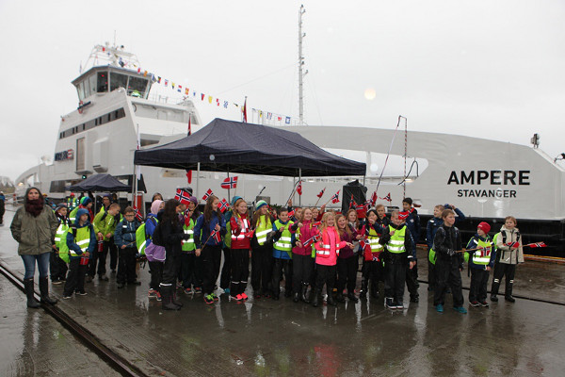
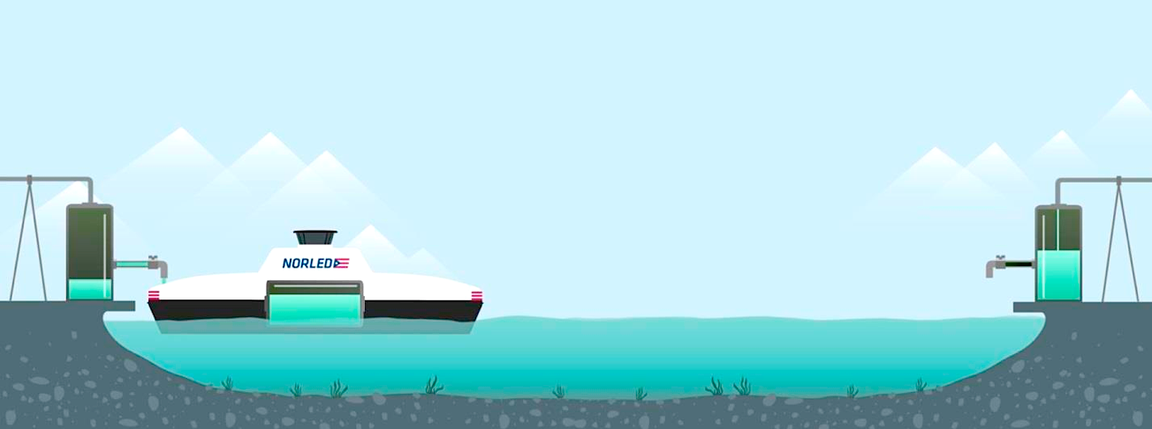
Notes:
First LNG offshore vessel
Through collaboration with some of the industry’s main players, the world’s first battery driven car ferry is now under construction at Fjellstrand and will start operating 1st of January 2015.
The world’s first large all-electric car ferry is a 100% battery driven catamaran in aluminium. The 80-meter long vessel will be able to carry 120 cars and 360 passengers. Ship of the year 2014

Slide 9
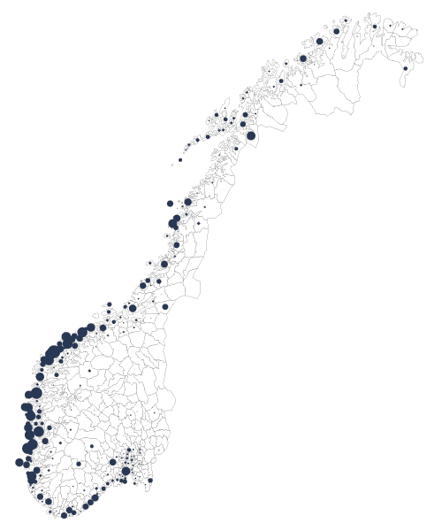
Seafarers in the North
Strong regional impact in the North – lacks strength to grow
Map shows employees in the maritime sector in percentage out of total number of employees in the private sector
(per municipality)
Maritime Møre
Design, equipment building and operation of offshore vessels
Maritime knowledgecenter– NTNU – Marintek - Sintef
Offshore West
All maritime activities related to development, operation and distribution of petroleum
Deep sea shipping (Oslo and Bergen)
Maritime Services– Finance, law and technologi
South-East: Electronics and subsea equipment
Drilling cluster in the South
Notes:
This is what the maritime cluster i Norway looks like.
The dots shows employees in the maritime sector in percentage out of total number of employees in the private sector
As you can see, we have traditional shipping or deep sea shipping in Oslo and Bergen, finance and service is also centered around the capital, with DNB and DNV as examples.
South East Norway has electronics and subsea, like Kongsberg for instance.
In the south a strong drilling cluster has developed, with National Oilwell at the center of it.
South west with Stavanger as the oil-capital and especialiy the north west is dominated by offshore ship-owning and building of offshore vessels like PSVs (platform supply vessel), anchorhandlers and IMR-vessels (Inspection, maintenance and repair).
In the North of Norway we hope that a future development of oil and gas in the Barents sea will give much needed growth impulses there. (The Northern sea route – Many seafarers actually live in the north of Norway)
All in all Norway has strong individual regional clusters that in sum makes up a very strong national maritime cluster.
Heavely depending on the offshore oil and gas activity.

Slide 10
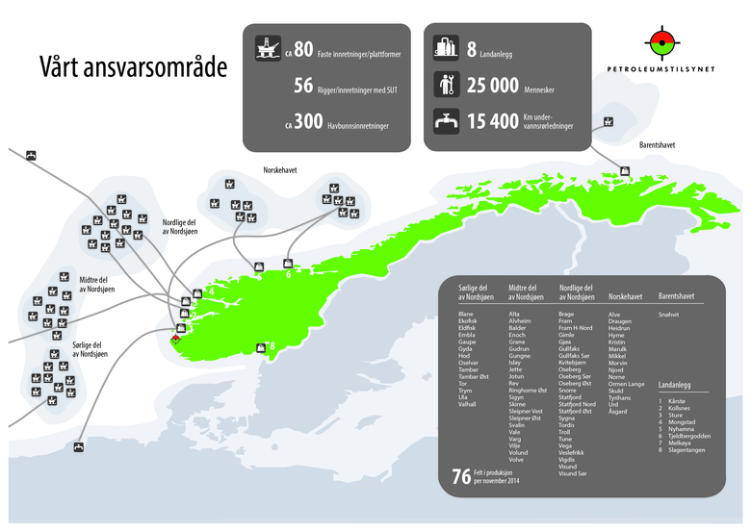
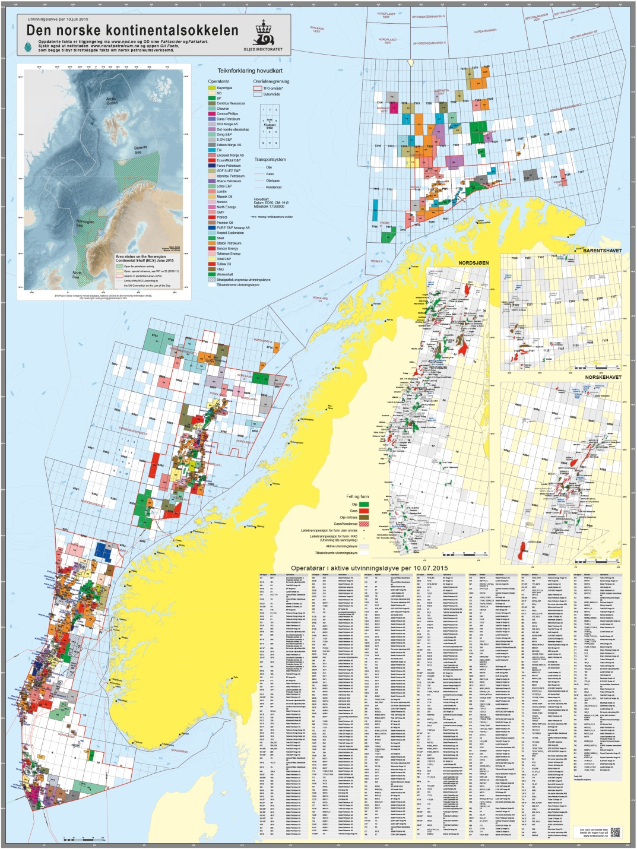

Slide 11
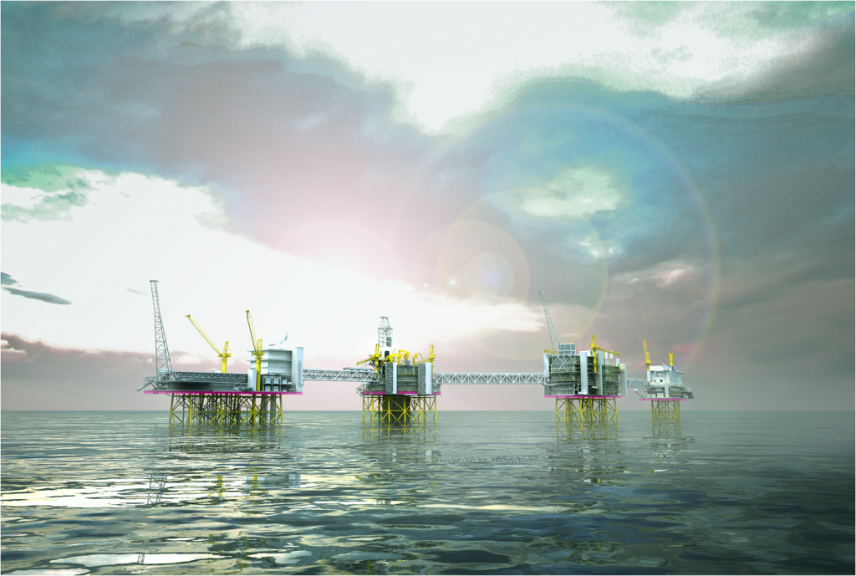
Johan Sverdrup. New green norwegian giant in north sea.
Start production 2019.

Slide 12

…Thank you for your attention!
mohammad.afzal@fellesforbundet.no

