Slide 1
IndustriALL Global Union
Introduction IndustriALL and activities on
ICT, Electrical & Electronics
Kan Matsuzaki
IndustriALL Globa Union
24 April 2013, Singapore

Slide 2
Building Unity and Power
115 countries
355 unions
20 million workers
100 countries
200 unions
25 million workers
110 countries
217 unions
10 million workers
50 million workers
over400 unions
140 countries

Slide 3
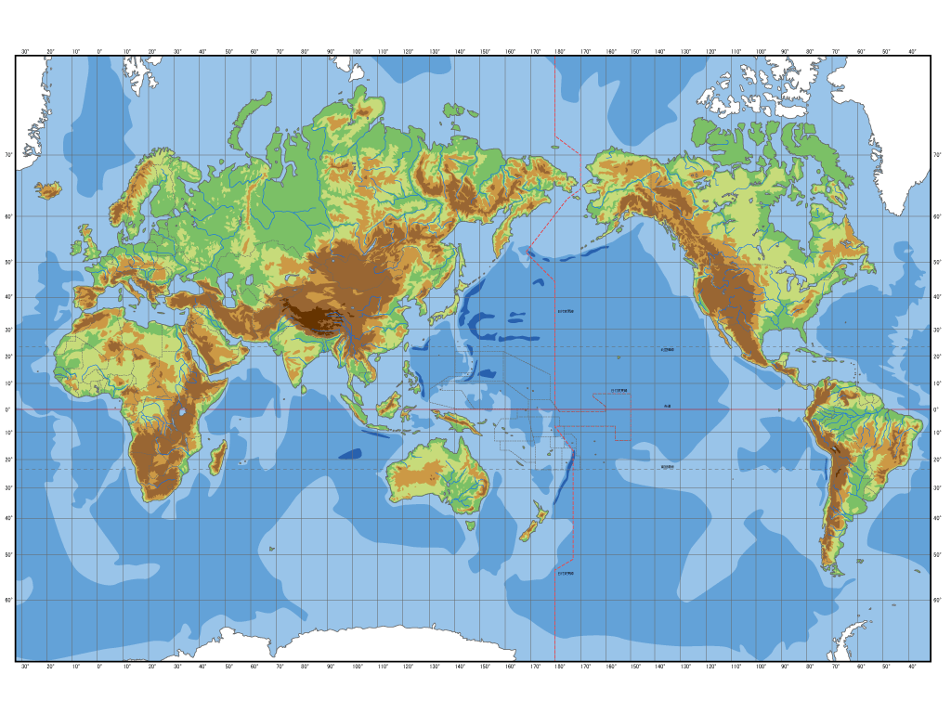
HQ and Regional Offices
Geneva, Switzerland
IndustriALL HQ
Moscow, RUSSIA
CIS countries
SINGAPORE
Southeast Asia/Pacific
New Delhi, INDIA
South Asia
Johannesburg, SOUTH AFRICA
East&Southern Africa
Montevideo, URGUAY
Latin America&Caribbean

Slide 4
List of industrial sectors within IndustriALL’s jurisdiction
Industrial Sectors(15)
Aerospace | Automotive
Base metals | Chemical, Pharmaceutical and Bio-sience
Energy | Industrial and Environment Services
Glass, Ceramic, Cement and Associated Industries | ICT, Electrical and Electronics
Mechanical engineering | Mining and DGOJP
Pulp and Paper | Rubber
Shipbuilding and Shipbreaking | Textile, Leather, Garment Shoes and Textile Services
Service and Miscellaneous Industries
Cross Sectoral groups(2)
Women | Non-Manual

Slide 5
3 Key Points on IndustriALL GU’s Action Plan
First, organizing and building stronger unions. We need to increase our membership to build more power. We need to organize everyone, also precarious workers.
Second, trade union rights. We need to make sure that every worker has the right to join a union of his/her choice and enjoy the protection of a collective agreement. We need to react to every violation by a government or a company.
Third, fighting for a new economic and social model that puts people first. We need to put pressure on political decision-makers for investments in the creation of good quality jobs instead of precarious jobs, for the growth of manufacturing industry instead of financial speculation, and for comprehensive social protection for all citizens.

Slide 6
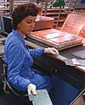
ICT, Electrical & Electrionics Sector
Work in the electrical and electronics sector deals with a wide range of companies producing consumer electronics, computer hardware, software and others. IndustriALL aims at developing trade union strategies for the sector and improving and strengthening the information exchange in transnational companies and supply chains.
The main purpose of the Steering Committee
Lead the work in the sector and discuss strategies on MNCs, trade union networks, GFAs, organizing, union rights, precarious work and specific industrial policy.
The affiliates who organize ICT E&E workers and would like to actively take part in the policy making process in the sector are eligible for participating at the meeting.

Slide 7
World’s Top IT Companies by Revenue (2012)
Industry | Industry | Employees | HQ
Samsung Electronics | Electronics | 371,700 | South Korea
Apple | Electronics | 76,100 | USA
HP | Hardware | 331,800 | USA
Foxconn | Electronics | 1,230,000 | Taiwan ROC
IBM | Computer Service | 433,300 | USA
Panasonic | Electronics | 327,500 | Japan
Microsoft | Hardware/Software | 94,000 | USA
Dell | Hardware | 88,400 | USA
Amazon.com | Internet | 173,100 | USA
Fujitsu | Hardware/Software | 104,700 | Japan
Very low or No union density with IndustriALL GU
Notes:
The list includes those companies whose primary business activities are associated with Information technology industry which includes computer hardware, software, electronics, semiconductor, internet, telecom equipment, e-commerce and computer services. Note: The list is limited to companies with annual revenues exceeding 50 billion USD.

Slide 8
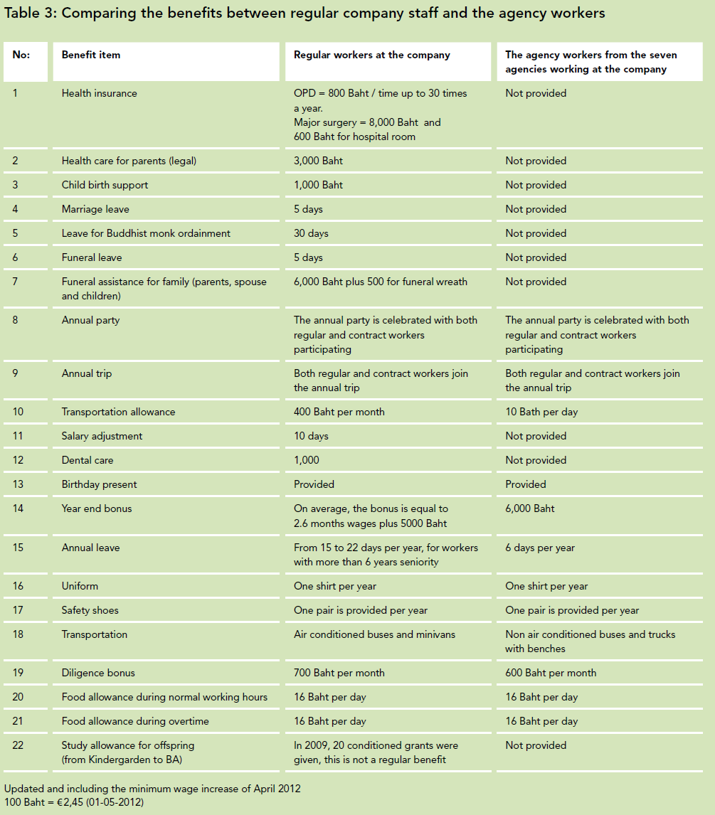
Precarious work in ICT E&E sector
The ILO’s World of Work report 2012
“The increase in involuntary part-time and temporary
employment has been larger than the increase in
unemployed and permanent jobs since the crisis. This
clearly shows that during the crisis more precarious
employment was created.”
Source: SOMO Paper “Temporary agency work in the electronics sector” May 2012

Slide 9
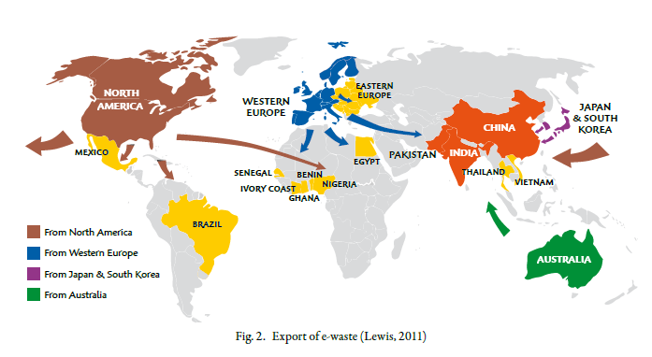
No union involvement/presence in e-waste workplace
Source: ILO “The global impact of e-waste:Addressing the challenge” 2013
Workers’ exposure
in developing countries
Long-term effects on human
health and the environment
Child labour at
e-waste recycling sites

Slide 10
Priority Issues in the sector
Organizing and Fight against Precarious Work
- Trade union rights, precarious workers and minimum wages
- Non-Manual workers, Women workers, Migrant workers etc.
- Sharing good practices of union activities
Promoting Sustainable Industry and Workplace
- sustainable issues including environment, OHS, e-waste, etc.
- Seeking for synergies with other sectors such as electric power(eg. Smart grid)
- Improving workers’ status and working conditions,
and securing employment
- Developing the trade union networks in MNCs and GFAs

Slide 11
Current GFAs of IndustriALL
Current agreements(43agreements) IndustriALL has existing GFAs with the following multinational corporations.
Aker, AngloGold, BMW, Bosch, Brunel, Daimler, EADS, EDF, Electrolux, Endesa, Eni, Evonik, Ford, Freudenberg, GDF Suez, GEA, Indesit, Inditex, Lafarge, Leoni, Lukoil, MAN, Mann + Hummel, Mizuno, Norsk Hydro, Norske Skog, Petrobras, Prym, PSA Peugeot Citroën, Renault, Rheinmetall, Rhodia, Röchling, Saab, SCA, Siemens, SKF, Statoil, Umicore, Vallourec, Volkswagen, ZF
Future possible negotiation: SEB

Slide 12
Building Networks
The seven basic principles to establish a network
1. A political mandate from the affiliates involved. A network can be initiated by the IMF or its affiliates, after which a sufficient amount of affiliates need to commit themselves to building and participating in the network.
2. Trade unions in the home country of the TNC play a vital role in establishing a network and in making it function. IMF affiliates with membership in the company should be consulted and involved at an early stage of the process. The initiative from the union in the home country of the TNC is an important element.
3. The networks should be independent union bodies. From that independent position, they could pursue recognition from the company, including financial support where appropriate, provided they maintain their independence. In some cases, it may be useful to invite other organizations, in particular those that could facilitate communication and cooperation due to their regional and professional knowledge. The decision on inclusion rests with the participants of the network.
4. The network should also be transparent and open to all unions that wish to participate with the agreement of the IMF affiliates.
5. Each union itself decides over who participates or not in the networks recognizing the importance of representation and participation from the shop floor.
6. An action plan should be developed to set out the objectives, priorities, structure, ways of communication, role of the coordinator, etc. This can be done through a coordination meeting or electronically. There are specific measurable objectives. This can vary from network to network but should have common denominators as set out in the section on the roles of trade union networks.
7. The goal of the network is to increase the power of the unions vis-à-vis the company at the national, regional and global levels.

Slide 13
MNCs stuation in ICT, E&E sector on GFAs, TUNs, and Organizing
IndustriALL affiliate unions
No unions or very low union density (except China)
GFAs
Unions in the home country
Non affiliates in the home country
Samsung
Foxconn
Apple
Haier
BYD
Suntech
etc.
Electrolux
Indesit
Panasonic, Hitachi, Toshiba, Mitsubishi Elec., Sharp, LG, Schneider, Nokia, Philips, etc.
Sony
Epson
etc.
SEB
IBM
(HP)
Siemens
Alliance with UNI, IndustriALL Europe
Trade Union Network
GFAs
Organizing
Need to follow recommendations on GFA and TUN conference in Oct. 2012
Need to develop targeting strategy and organizing project

Slide 14
Program of Activities 2013 on ICT, E&E (Exco, Dec. 2012)
Establish a Steering Committee to lead the work in the sector and discuss strategies on MNCs, trade union networks, GFAs, organizing and union rights.
Support organizing and union building with a focus on Southeast Asia (partially supported by externally funded projects) whilst supporting increased union density in membership in the rest of the world
Develop industrial policies on specific issues including e-waste, health and safety
Enhance the IBM Global Union Alliance with UNI
Continue to develop trade union networks in Siemens, IBM, Nokia, Philips and Schneider Electric, seek possibilities to establish networks in Asian-based brand companies. Special efforts will be waged for Siemens, particularly in activities in India and China
Research mission to China to explore the situation of electronics workers and develop action with particular attention on Foxconn, Suntech, Haier and BYD
Establish synergies between electric power and ICT, electrical and electronics sectors
Develop cooperation with other organizations and networks such as GoodElectronics
Include the sector in the Living Wage campaign

Slide 15
Thank You
Website
www.industriALL-union.org
Industri ALL

